Slide 1
CLUSTERING
EMPLOYEE SEGMENTATION ON ABSENTEEISM
Under Guidance:
Dr. Aakansha Gupta
By-
Arjun Maurya

Slide 2
INTRODUCTION
Employees have been absent during work hours due to various reasons.
This may have adverse effects on the team/department .
Clustering techniques helps an organization to understand the reasons why employees tend to be away from work.
By creating clusters , attention can be given to address such issues.
OBJECTIVE
Create an employee cluster to show the absenteeism at work.

Slide 3
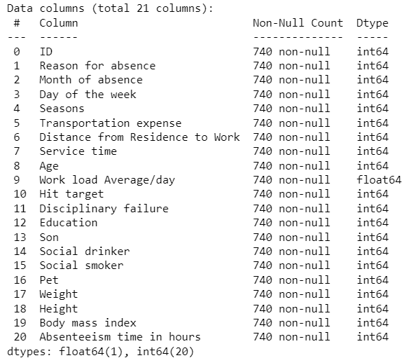
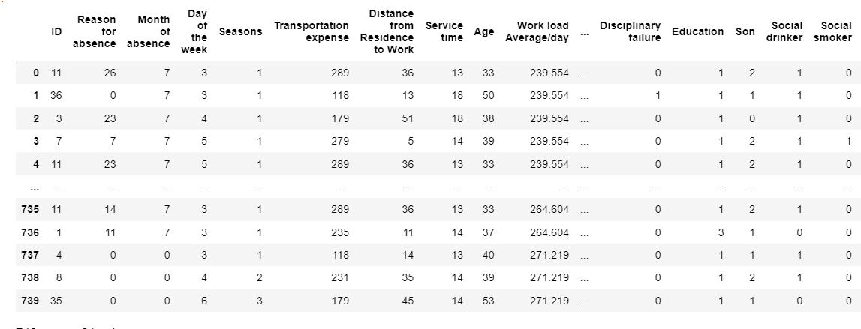
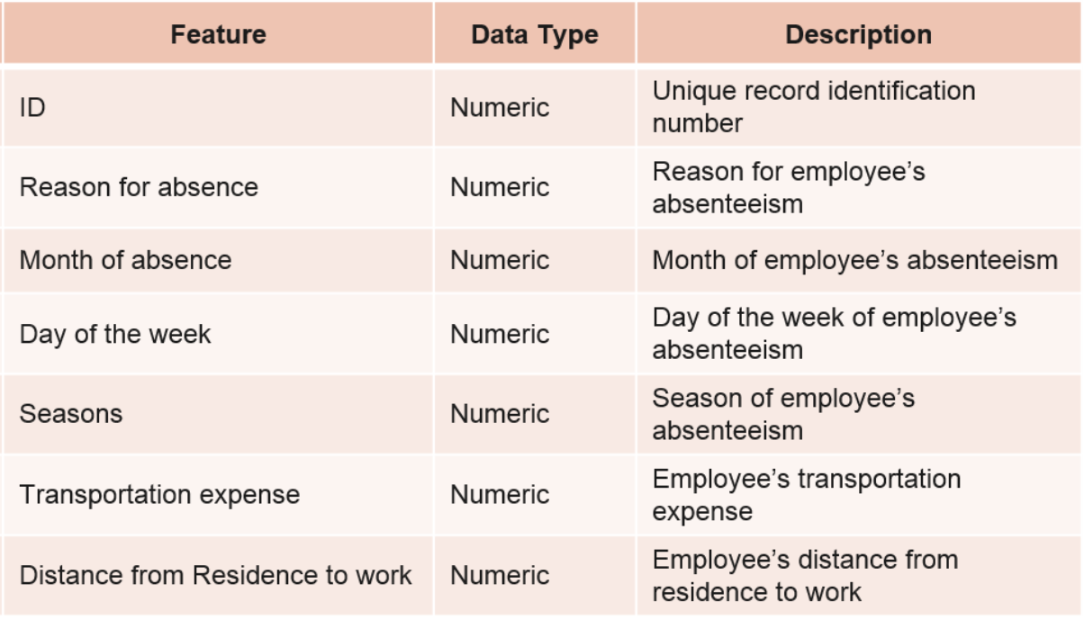
DATA COLLECTION
Imported required libraries.
Read the data to a Data Frame.
740 columns and 21 rows.
Description of the features

Slide 4
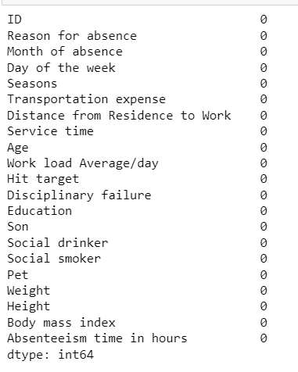

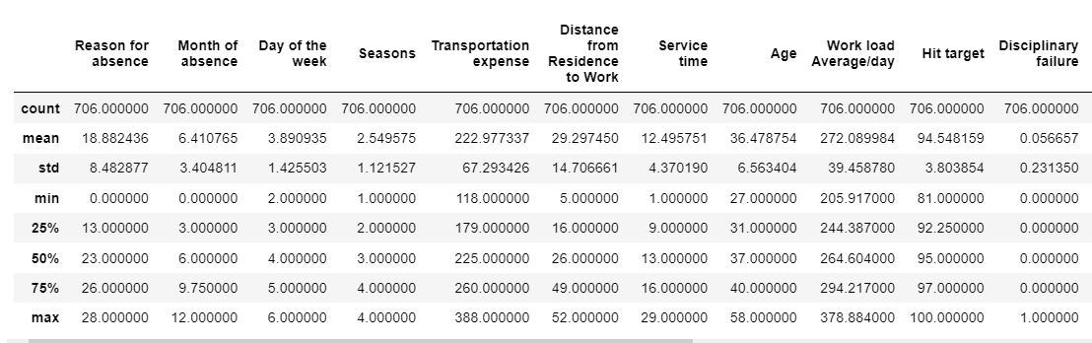
DATA EXPLORATION
Datatypes of all the features is integer.
No null values
34 duplicates found and dropped
A statistical description of all the features.

Slide 5
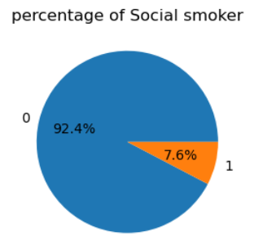
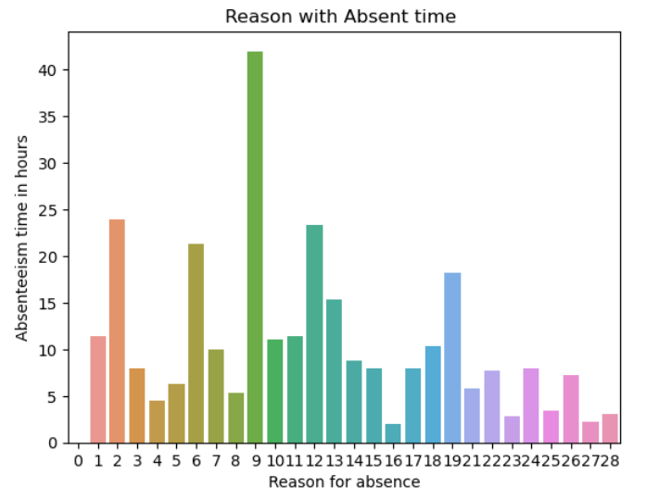
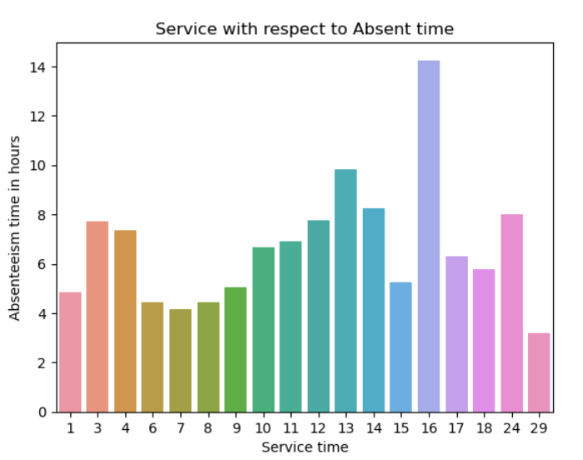
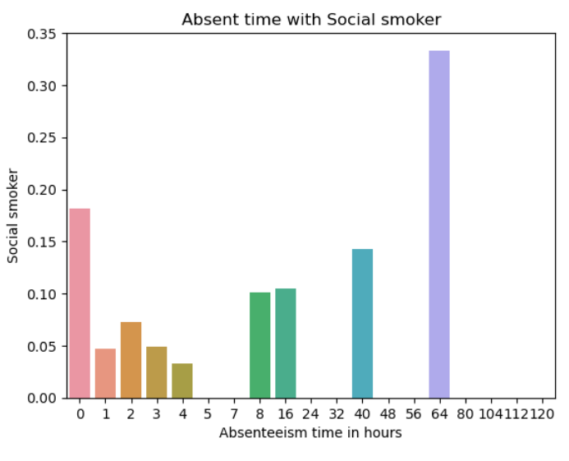
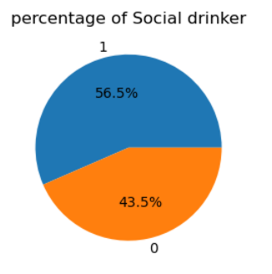
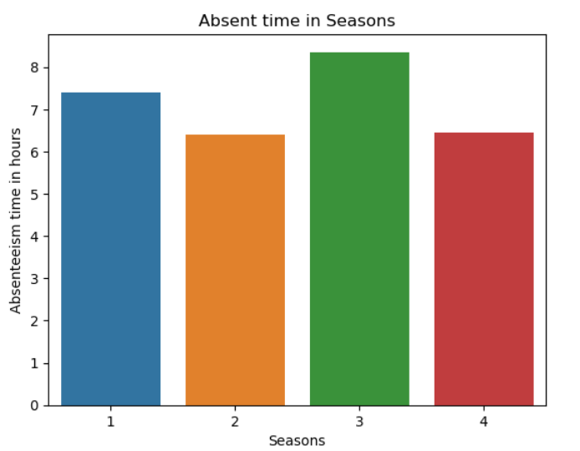
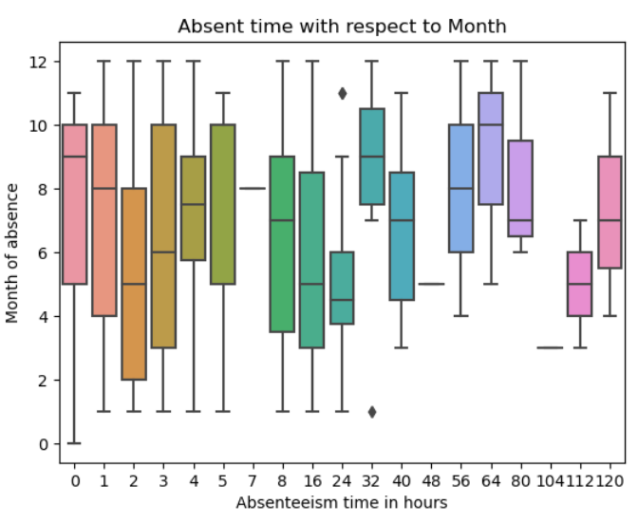
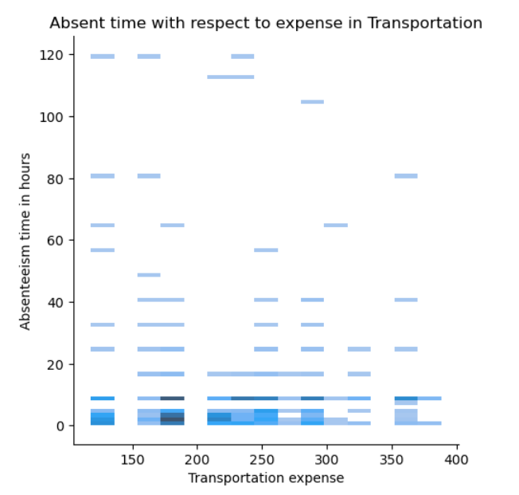
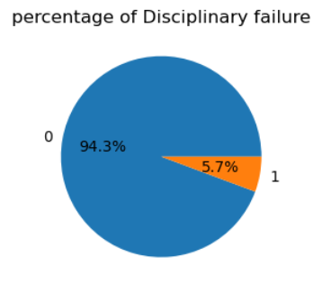
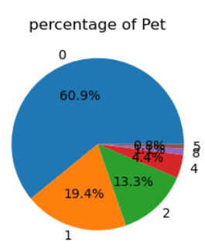
EXPLORATORY DATA ANALYSIS

Slide 6
INTERPRETATIONS
56.5% of the employees are Social drinkers.
92.4% of the employees are Non smokers.
60.9% of the employees do not have pets.
Only 5.7% of the employees have disciplinary failure.
Employees with high absenteeism time are mostly smokers.
Employees with maximum absenteeism time were absent from the months six to nine.
Employees have maximum absenteeism time in season three.
For transportation expenses around 250 ,employees have high absenteeism time.
Employees with Service time of 16 have the maximum absenteeism time.

Slide 7
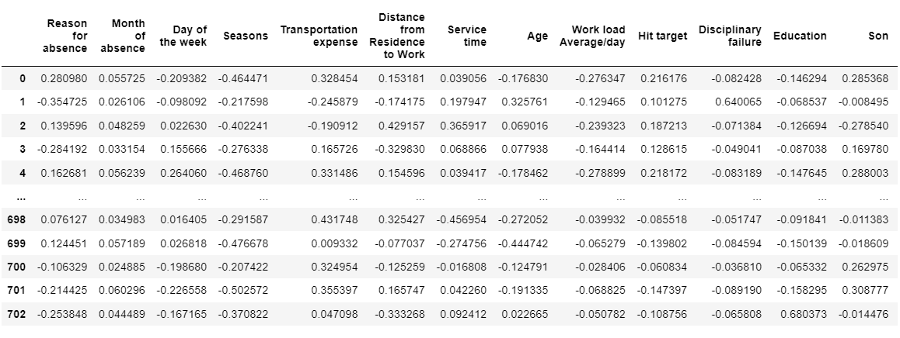
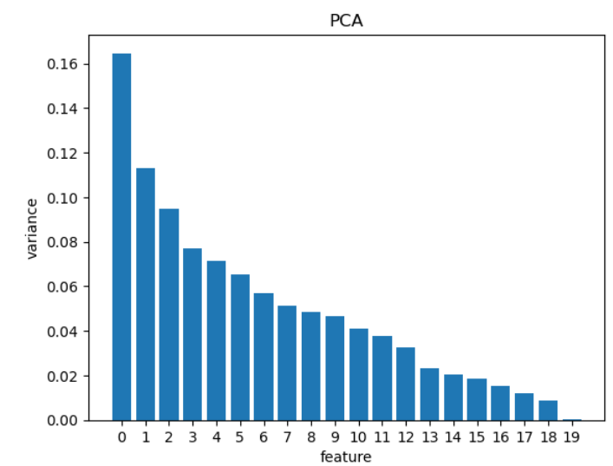
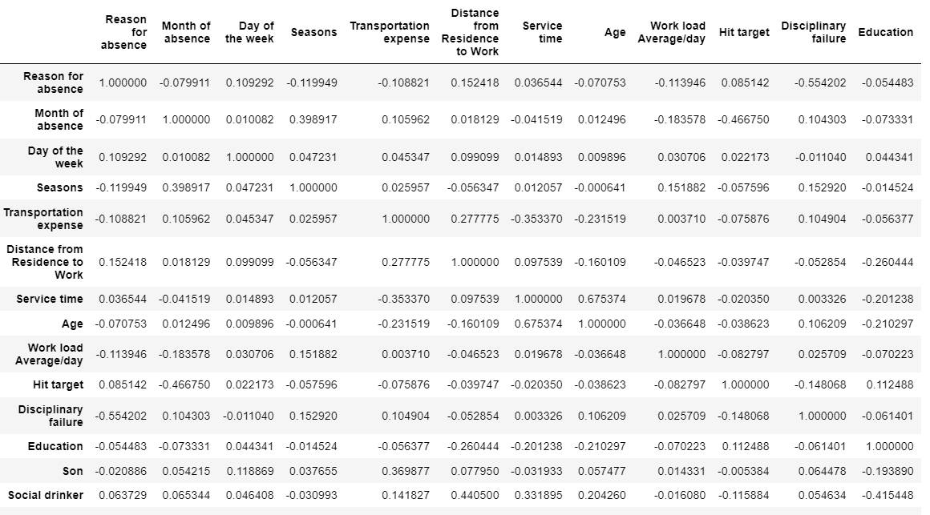
DATA PREPROCESSING
Scaling using StandardScaler and normalized.
Principle Component Analysis
Correlation

Slide 8
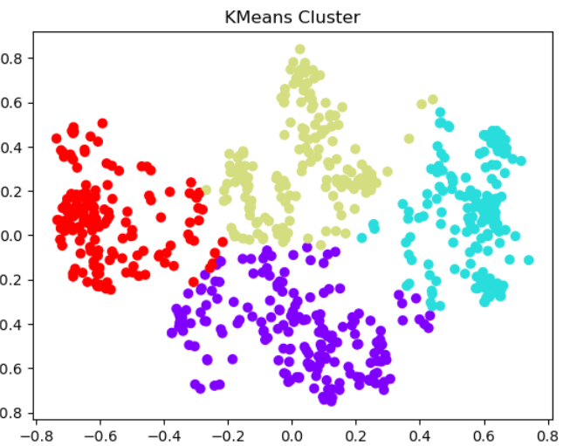
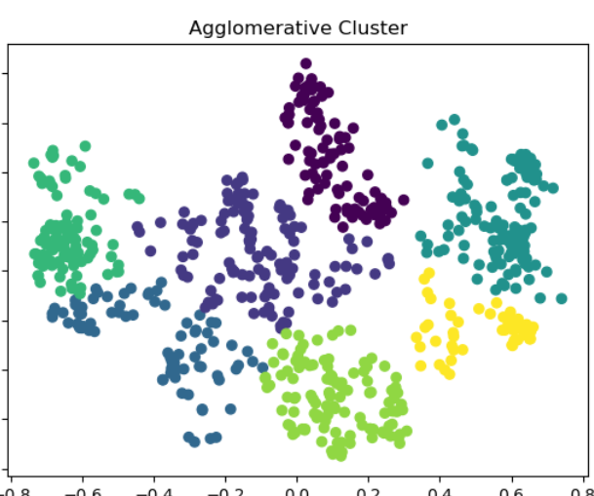
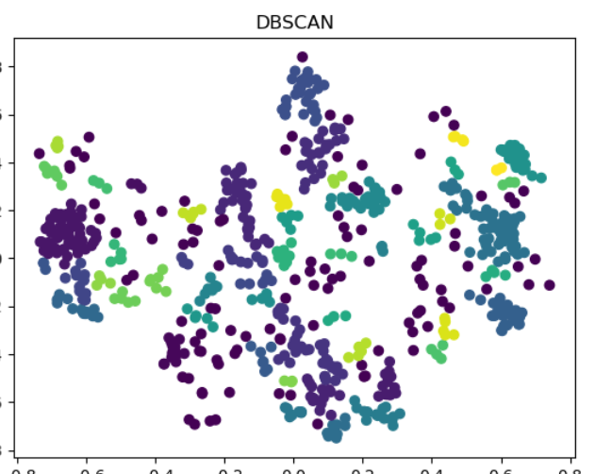
MACHINE LEARNING MODELS
The Machine Learning models used for Clustering:
KMeans Clustering
Hierarchical Clustering
Density Based Clustering

Slide 9
MODEL COMPARISON
SILHOUETTE SCORE | KMEANS CLUSTERING | HIERARICHICAL CLUSTERING | DENSITY BASED CLUSTERING
Silhouette Score | 0.4811 | 0.4441 | 0.1893

Slide 10
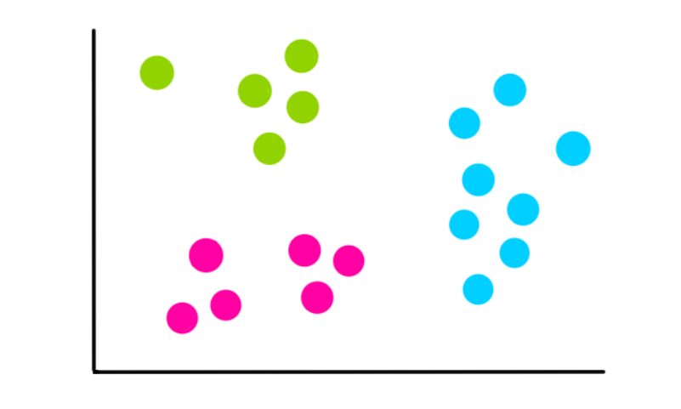
CONCLUSION
Based on the Silhouette Score of the models , Kmeans seems to perform well.
For Kmeans Clustering model the Silhouette Score is highest.

Slide 11
THANK YOU

